Slide 1
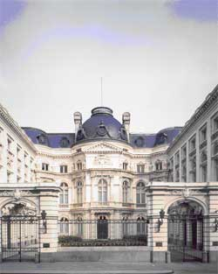
Joint Seminar
Brussels 2017

Slide 2
Future evolution of public sector audit in Europe
Peter Welch, Director, European Court of Auditors

Slide 3
A changing world
Connected
Sharing data
Using apps
Using AI
Expecting high
standards of
Corporate
Governance
Overheating
No privacy
Instant judgement
Anti-expert
Delocalized
Backing “strong”
leaders
Operating in real time

Slide 4
Are the old attributes of auditors still relevant?
Independence
Special skills
An (elite) qualification
Experience of other bodies
Listening(!)
Understanding the business
Yes, but
Auditors will be under pressure
to report more quickly
Make governance a key theme
Use IT to perform audit and to
report
Expand their experience of other
bodies

Slide 5
Old and new challenges
What kind of assurance was the auditor providing?
Accounts - but often on the basis of local standards
Legality and regularity - with a wide variety of mandates
Performance - with a wider variety of mandates
Compliance – following procedures laid down in instructions

Slide 6
Old and new challenges
Do they still need us?
Gathering data? Interpreting data?
Do we give people the right experience?
No single answer - but the more we do to share experiences and people the better prepared we are.
Do local accounting rules still matter?
Less than global rules…If your organization reports on nonstandard rules, expect someone to have an app to restate them soon.
Do we still understand the business?
In an age of social media do politics, accountability and public administration work the way they did?

Slide 7
Some conclusions
We face big challenges
Sharing experience is essential
Encouraging our staff to spend time working on projects in other organisations will help us keep up
We need IT that is integrated into the audit process.
There is a big role for EUROSAI and for conferences like this
We could work together with ECIIA on improving public sector corporate governance in Europe

Slide 8
Thanks!

