Slide 1
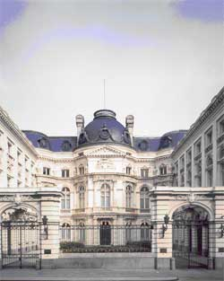
Joint Seminar
Brussels 2017

Slide 2
Risk Management in the Public Sector
Soledad Llamas Tutor
Internal Audit Manager
Canal de Isabel II, Spain
Cooperation Committee ECIIA_EUROSAI

Slide 3
GESTIÓN DE RIESGOS
RISK MANAGEMENT

Slide 4
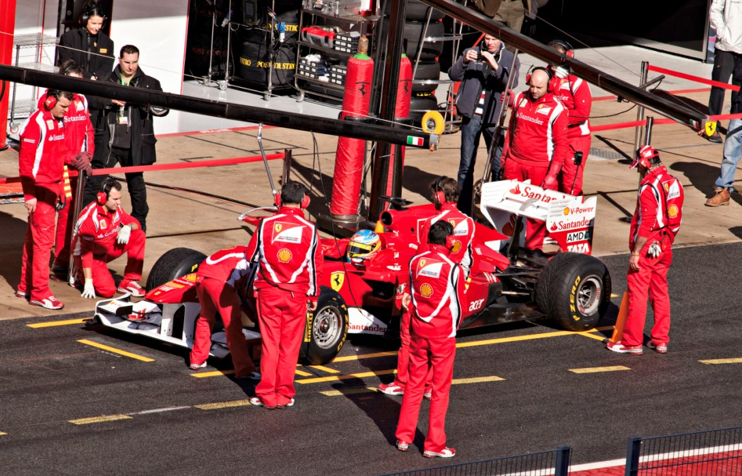
PIT STOP F1
GOAL: Change the wheels and make adjusts in less than 5 sec.
Risks:
Forget some element.
Stall the car.
No coordination.
Grease in pit lane.
Bad comunication between the workers and the driver

Slide 5
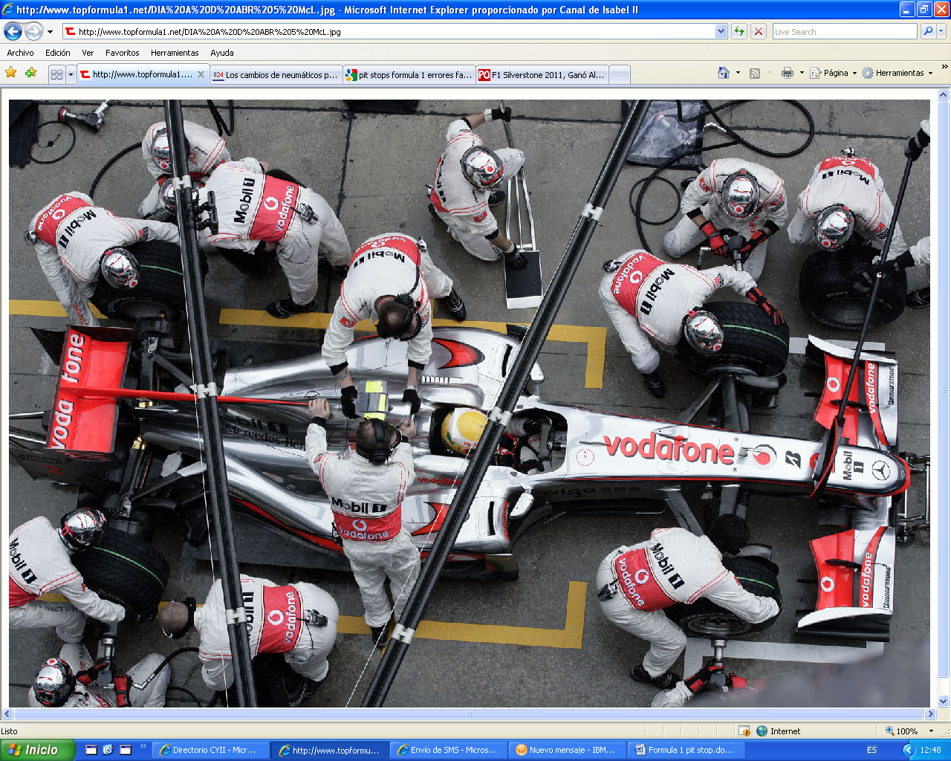
What is the probability?
How many times did it happen?
Is it possible to repeat?
RISK
What is the impact?
How many seconds do we loss if it happens?

Slide 6
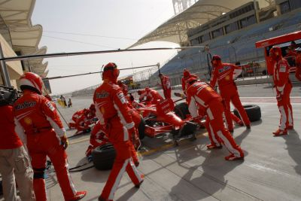
Risk: Bad comunication between the workers and the driver
Probability: High
Impact: Very high
Control: Lollipop Man
GESTIÓN DE RIESGOS
Risk: Stall the car
Probability: Low
Impact: Very high
Control: Starter man
Risk: Grease in pit lane.
Probability: Very high
Impact: Low
Control: Cleaning and have time

Slide 7
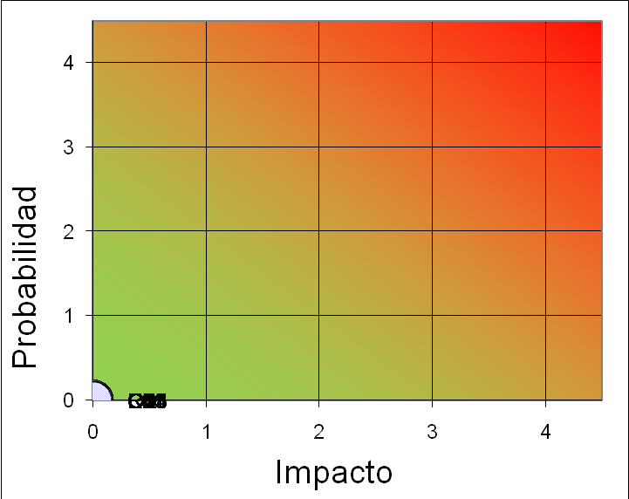
Risk: Bad comunication between the workers and the pilot.
Risk: Bad comunication between the workers and the pilot.
Risk: Bad comunication between the workers and the driver
GESTIÓN DE RIESGOS
Risk: Creek the car .
Risk: Creek the car .
Risk: Stall the car.
Risk: Grease in the pit lane.
Risk: Grease in the pit lane.
Risk: Grease in pit lane.

Slide 8
Risk: Bad comunication between the workers and the driver
GESTIÓN DE RIESGOS
Risk: Stall the car.
Risk: Grease in pit lane.

Slide 9
GESTIÓN DE RIESGOS

Slide 10
Risk management

Slide 11
Risk management
1. Risks
Identify risks.
2. Evaluation
Define common rules to assess risks.
Evaluate likelihood and impact of risks.
Indicators. KRI.
3. Controls
Define controls.
Evaluate the design and effectiveness of controls.

Slide 12
Risk management
1. Risks. Identify risks.
COSO. ERM
IIA
Inside company (whistleblowing)
Evaluation of incentives to workers
Possible removal of controls
Access IT systems

Slide 13
Risk management
1. Risks. Identify the risks.
Lack of control to prevent the dividing of a public contract into several smaller ones.
Conflicts of interest in public procurement.
Absence of periodic audits. Inadequate protection of confidential information. Absence of code of conduct. Conflicts in the working environment.
Examples
Excessive staff turnover. Lack of back up for key staff. Lack of rotation of personnel in sensitive posts.
Inadequate management of access control systems. Very difficult to achieve objectives. Low salaries in relation to the market.

Slide 14
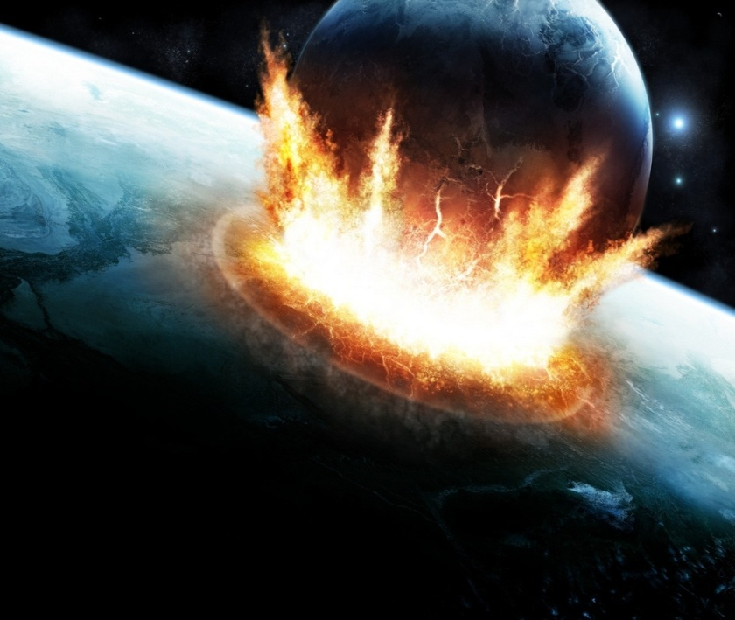
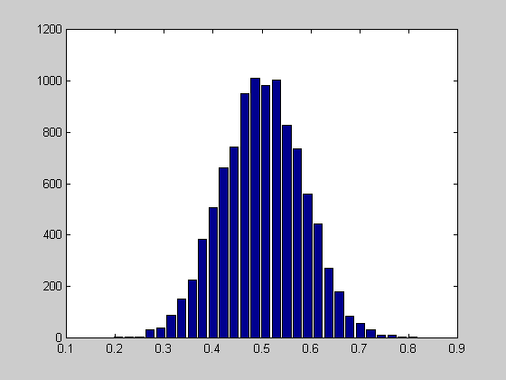
Risk management
2. Evaluation. Define common rules to assess risks.
Impact
Likelihood
How important the effects could be if it happens?
The probability of it happening

Slide 15
Risk management
2. Evaluation. Define common rules to assess risks.
Examples
Likelihood:
1 - Low | 2 - Moderate | 3 - Likely | 4 – Very likely
<20% | 21% - 50% | 51% - 90% | > 90%
It could happen, but it is very unlikely | It could happen | The probability of occurrence is greater than it not happening | You could almost say with certainty that it will happen

Slide 16
Risk management
2. Evaluation. Define common rules to assess risks.
Examples
Impact
1 - Low | 2 - Moderate | 3 - Severe | 4 – Very severe
Finance – Reduction of EBITDA
<3% | 3%-5% | 6%- 10% | > 10%
Strategic/Reputational
Low impact on reputation | Moderate impact on reputation | Important impact on reputation | Very important impact on reputation
Lack of/problems with the drinking water
Affects fewer than 1.000 people | Affects between 1.000 and 3.000 people | Affects between 3.000 and 5.000 people | Affects more than 5.000 people
Loss of water
< 2.000 m³ | < 5.000 m³ > 2.000 m³ | < 10.000 > 5.000 m³ | >10.000 m³
News in media: press, internet
Local media | Some news in local and national press and tv | National media | International media

Slide 17
Risk management
2. Evaluation. KRI. Key risk indicators
Impact
Impact
Likelihood
Likelihood
Likelihood

Slide 18
Risk management
2. Evaluation. KRI. Key risk indicators
Examples
KRI
Risk: Lack of agility in the public procurement process
KRI. Impact:
€ for public procurement in one year.
KRI. Likelihood:
- Nº of contracts with processing time greater than XX days.
- (%) Number of contracts with processing time greater than XX days / Total number of contracts

Slide 19
Risk management
2. Evaluation. KRI. Key risk indicators
Examples
KRI
Risk: Lack of agility in the public procurement process
KRI. Impact:
€ for public procurement in one year.
Type | KRI | 1 | 2 | 3 | 4 | KRI value
Impact | € for public procurement in one year | 20 | 150 | 300 | 500 | XXXX
Examples KRI
Risk value

Slide 20
Risk management
2. Evaluation. KRI. Key risk indicators
Examples
KRI
Risk: Lack of agility in the public procurement process
KRI. Likelihood:
- Nº of contracts with processing time greater than XX days.
- (%) Number of contracts with processing time greater than XX days / Total number of contracts
Type | KRI | 1 | 2 | 3 | 4 | KRI value
Likelihood | Nº of contracts with processing time greater than XX days | 20 | 40 | 100 | 500 | YY
Likelihood | (%) Number of contracts with processing time greater than XX days / Total number of contracts | 5 | 10 | 15 | 20 | ZZ
Examples KRI

Slide 21
Risk management
3. Apetite
Risk apetite framework (RAF)

Slide 22
Risk management
3. Controls
Define controls
Evaluate the design and effectiveness of controls.
Design
Effectiveness

Slide 23
Risk management
3. Controls
Define controls.
Alert in the public procurement system when a dossier is close to the time limit.
Compulsory initial course to all new contractors on the ethical code.
Correct use of Whistleblowing.
Examples

Slide 24
Risk management
3. Controls
Evaluate the design and effectiveness of controls.
Design
Is it operational?
Has the control a person responsible ?
If changes have occurred, has it been modified?
Examples

Slide 25
Risk management
3. Controls
Evaluate the design and effectiveness of controls.
Effectiveness
Are the times defined for the phases of government procurement reviewed? (Evidence of record and notice of change)
Risk. Lack of control to prevent the dividing of a public contract
into several smaller ones.
Automatic control
Examples

Slide 26
Conclusions

Slide 27
PROCESS IN THE RISK MANAGEMENT
RISK
KRI
Key Risk Indicators
Likelihood
CONTROLS
Impact
Design
Effectiveness

Slide 28
Thank you for your attention
Soledad Llamas
sltutor@canaldeisabelsegunda.es

