Slide 1
EUROSAI / ECIIA, JOINT SEMINAR, BRUSSELS, 10-11 MAY 2017
International Certification in Audit
Ciarán Spillane,
Principal Advisor,
European Commission,
Internal Audit Service

Slide 2
Internal Audit in the European Commission
The mission of the Internal Audit Service is to provide to the Commission and EU autonomous bodies ("audited entities") independent, objective assurance and consulting services designed to add value and to improve their operations.
Institution | Team size (all Staff)
Commission - IAS | 160
Commission – Ex-Post + Executive Agencies | 420
Commission - Total | 580
Other Institutions IA (Brussels) | 20
Total | 600
Audit
(Internal & Ex-post Control) teams in EU Institutions (Brussels)

Slide 3
Professional qualifications of IAS Staff

Slide 4
IAS organization chart
Director-General
Manfred KRAFF
A: Audit in EU Agencies and other autonomous bodies
Reinder VAN DER ZEE
Audit Unit A.1
Ilian KOMITSKI
Audit Unit A.2
Friedrich BRAEUER
B: Audit in Commission and Executive Agencies I
Jeffrey MASON
Audit Unit B.1
Carlo BILLI
Audit Unit B.2
Doriane GIVORD-STRASSEL
Audit Unit B.3
Filip VERHOEVEN
Audit Unit B.4
Christoph NERLICH
C: Audit in Commission and Executive Agencies II
Cristiana GIACOBBO
Audit Unit C.1
Laura CANDELORO
Audit unit C.2
Volker ROKOS
Audit Unit C.3
Rudi DRIES
(Acting Head of Unit)
Audit unit C.4
Edwin CROONEN
Assistant to the Director-General
Adrian MIRCEA
01: Quality Assurance, Resources, Administrative coordination and Communication
Sunil BEERSING
Secretariat of the Audit Progress Committee
Principal adviser
Ciaran SPILLANE

Slide 5

Internal Audit Training Programme (IATP)

Slide 6
Internal Audit Training Programme (IATP)
Objective of in-house IATP: guarantee continuous professional development of our IAs to meet professional standards set by the Institute of Internal Auditors (IIA) for internal auditing.
Ultimate goal of IATP: prepare IAs for internationally recognised audit certification and to pass a certification test either for:
Certified Government Auditing Professional (CGAP®),
Certified Internal Auditor (CIA®),
Certified Information Systems Auditor (CISA®), and/or
other certification programmes (e.g. Chartered Accountant 8th Dir.).
Strengthens the credibility of our auditors and increases leverage in making IAS' recommendations accepted.

Slide 7
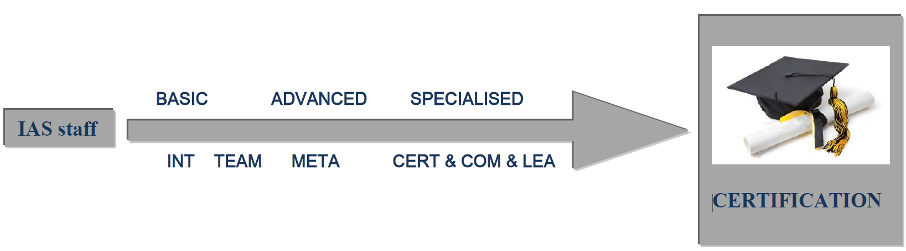
Internal Audit Training Programme (IATP)
Continuing Professional Education (CPE)
Participation to IATP courses entitles the holders of IIA professional certifications (CIA, CGAP, CCSA, CFSA, etc.) to CPE points.
IATP in 6 constituent parts

Slide 8
Internal Audit Training Programme (IATP)
Module | Duration | Objectives
INT 01-05 | Av. 2 days | Basic concepts, Risk Assessment,
TEAM 01-7 | Av. 4 hours | TeamMate (replacing GRC)
META 01-06 | Av. 2 days | Audit Methodology: understand / put into practice / audit tools
COM 02-04 | Av. 2 days | Interviewing; Meetings/Presentations; Written communication
LEA 01-02 | Av. 4 hours | How to lead audit; how to lead A.Team
Auditors' Forum | Av. 2 hours | Complements IATP. 6 * Year All EU IAs
CERT | Av. 4 days + self-study | Preparation for CGAP® certification exam

Slide 9
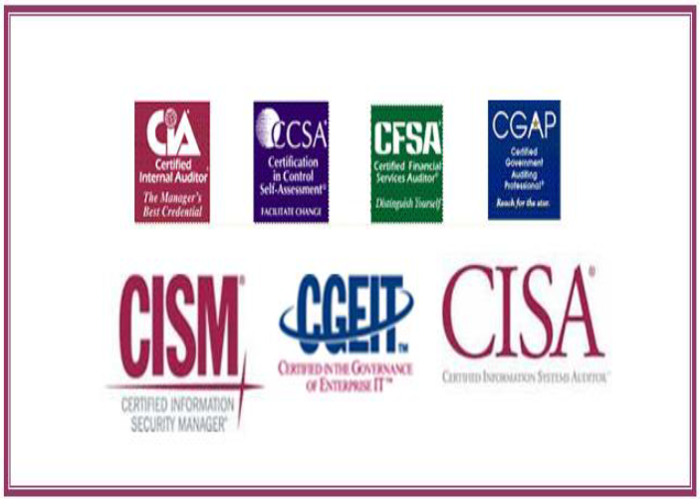

Professional Qualification (Certifications)

Slide 10
N° of IIA CERTIFICATIONS obtained

Slide 11
Internal Audit Training Programme (IATP)
CERT | Av. 4 days + self-study | Preparation for CGAP® certification exam
The Certified Government Auditing Professional® (CGAP®) is a specialty certification designed for and by public-sector internal auditing practitioners. The exam tests candidates' knowledge of the unique features of public-sector internal auditing — fund accounting, grants, legislative oversight, confidentiality rights, and more.
IAS pays for two courses after which the IA must complete at own expense.
Two versions of the CGAP examination:
International version, includes questions on the INTOSAI government auditing standards.
'pour mémoire' For public sector auditing professionals within the United States, includes questions on the United States’ Government Auditing Standards (Yellow Book).

Slide 12
Certified Government Auditing Professional® (CGAP®)
The exam covers 4 domains :
standards, governance and risk / control frameworks;
government auditing practice;
government auditing skills and techniques;
government auditing environment.
Items tested at the Awareness and/or Proficiency knowledge level. (115 questions | 175 minutes)

Slide 13
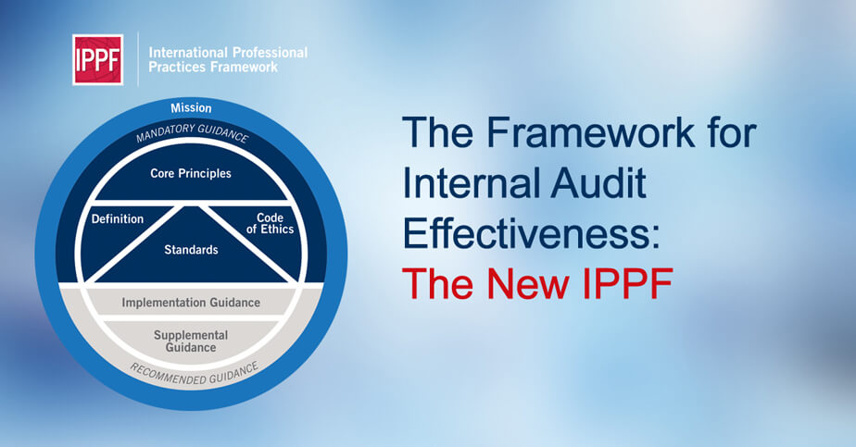
Certified Government Auditing Professional® (CGAP®)

Slide 14
Certified Government Auditing Professional® (CGAP®)
INTOSAI Standards: International Standards of Supreme Audit Institutions (ISSAIs) play a major role in auditing government accounts and operations and in promoting sound financial management and accountability in their governments.
INTOSAI has produced a number of standards including General Standards, Field Standards and Reporting Standards in Government Auditing.
International Standards on Auditing: Int'l Fed. of Accountants (IFAC) is the worldwide organisation for the accountancy profession. Established the International Auditing and Assurance Standards Board (IAASB) to develop and issue high quality auditing and assurance standards for use around the world.
International Standards on Auditing (ISAs) set out the basic audit principles and related practices and procedures. At the end of each ISA there is a Public Sector Perspective (PSP) which provides clarification or supplementary notes for specific public sector issues related to the ISA.

Slide 15
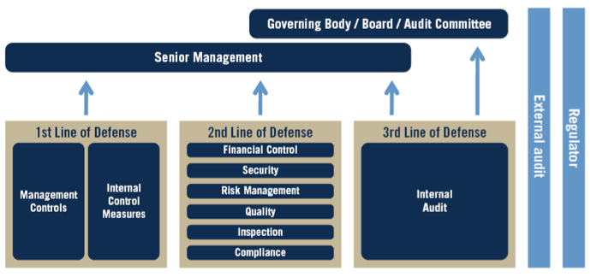
Certified Government Auditing Professional® (CGAP®)
The Three Lines of Defence Model

Slide 16
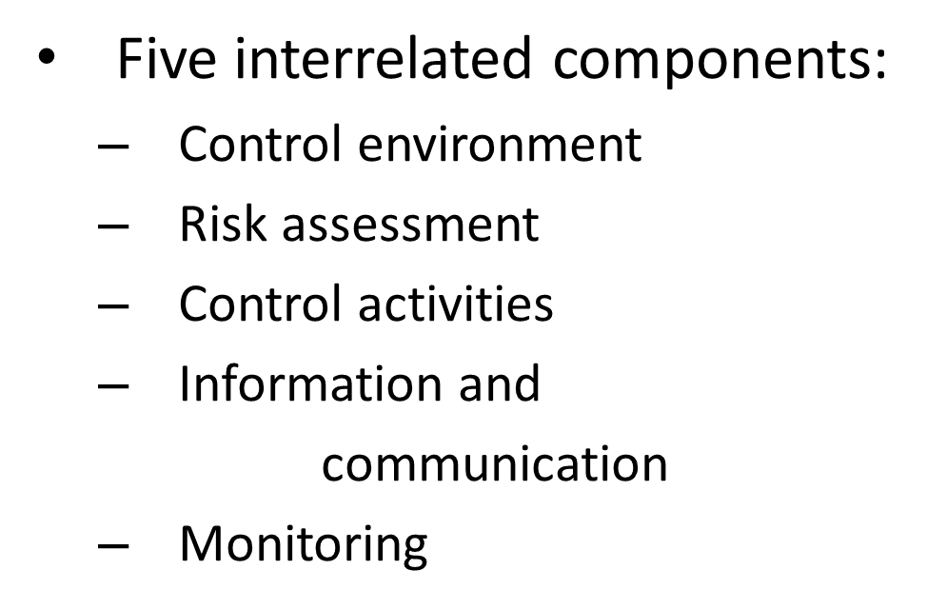
Certified Government Auditing Professional® (CGAP®)
Risk and control frameworks
Nota Bene: EC's Internal Control Standards based on COSO

Slide 17
Certified Internal Auditor (CIA)
The IIA's Certified Internal Auditor® (CIA®) certification is a globally accepted designation for internal auditors. It is a three-part exam that tests a candidate's knowledge of current internal auditing practices and understanding of internal audit issues, risks and remedies.
Part 1 – Internal Audit Basics
The CIA exam Part 1 topics tested include aspects of mandatory guidance from the IPPF; internal control and risk concepts; as well as tools and techniques for conducting internal audit engagements.
Note: Tested at the Proficiency knowledge level.

Slide 18
Certified Internal Auditor (CIA)
Part 2 – Internal Audit Practice
The CIA exam Part 2 topics tested include managing the internal audit function via the strategic and operational role of internal audit and establishing a risk-based plan; the steps to manage individual engagements (planning, supervision, communicating results, and monitoring outcomes); as well as fraud risks and controls.
Note: Tested at the Proficiency knowledge.
Part 3 – Internal Audit Knowledge Elements
The CIA exam Part 3 topics tested include governance and business ethics; risk management; organizational structure, including business processes and risks; communication; management and leadership principles; information technology and business continuity; financial management; and the global business environment.
Note: Tested at the Awareness knowledge level

Slide 19
Advantages of International Certification in Audit
The IIA's Certified Internal Auditor® (CIA®) certification is the only globally accepted designation for internal auditors. It is a three-part exam that remains the standard by which individuals demonstrate their comprehensive competence and professionalism in the internal auditing field.
Certifying body keeps examination process up to date;
Study at own pace. Flexibility to perform audit field work outside of HQ;
Staff acquire a minimum audit knowledge base giving more flexibility in allocation of IAs to audit engagements;
If numbers justify, internal courses given by contractors (after procurement procedure) – case of CGAP preparation;
IIA certifications (CGAP & CIA) favoured by EC Ex-Post Control directorates for study flexibility and minimum audit knowledge base;
Staff motivated by obtaining Int'l recognised certificate;
Staff mobility increased from investment in training/certification.

Slide 20
Disadvantages of International Certification in Audit
The IIA's Certified Internal Auditor® (CIA®) certification is the only globally accepted designation for internal auditors. It is a three-part exam that remains the standard by which individuals demonstrate their comprehensive competence and professionalism in the internal auditing field.
Unique working environment of EC means no one certificate fully matches needs;
IIA CGAP is good base but IAs (& ex-post auditors & IC & Risk Mgt. staff) need more advanced specialised certifications;
Staff possibly demotivated to learn non-relevant EU knowledge (& non-usable also!);
Staff turnover (exiting) in EC is low, so benefit of int'lly recognisable certification is less attractive as a driver/motivator.

Slide 21
International Certification in Audit
The IIA's Certified Internal Auditor® (CIA®) certification is the only globally accepted designation for internal auditors. It is a three-part exam that remains the standard by which individuals demonstrate their comprehensive competence and professionalism in the internal auditing field.
CONCLUSION
Overall EC IAS & other services are satisfied with contribution that International Certification in Audit brings to staff.
This in turn helps achievement of the IATP goals.

Slide 22

Questions?
Contact the Internal Audit Service:
ias-europa@ec.europa.eu

