Slide 1
EUROSAI Strategic Goal 1
(Professional Cooperation)
Thank you for your attention!
58th EUROSAI Governing Board meeting Vilnius, 14 June 2023
Notes:
Thank you very much, Kamila and Peter!
Since nothing new has happened since the GB meeting four weeks ago, we recycled the presentation from this occasion, although with one important additional information – you shouldn’t use this time slot for your bathroom break!

Slide 2
SG1 - PROFESSIONAL COOPERATION
Supporting effective, innovative and relevant audits by promoting and brokering professional cooperation
To promote audit-related cooperation by acting as a broker between members
To support the development of innovative audit approaches and methods making use of new technologies
To facilitate the sharing of knowledge and experience within EUROSAI and with external stakeholders and partners
Notes:
I hope everyone is back from the bathroom by now because here comes the very important information:
The annual SG1 meeting will be held on Wednesday 25 January 2023!
Please save the date and let us know if you want to present a new project or require a brainstorming session.

Slide 3
6th meeting of EUROSAI SG1
was held on 25 January 2023
50 participants
13 presentations
Notes:
I hope everyone is back from the bathroom by now because here comes the very important information:
The annual SG1 meeting will be held on Wednesday 25 January 2023!
Please save the date and let us know if you want to present a new project or require a brainstorming session.

Slide 4
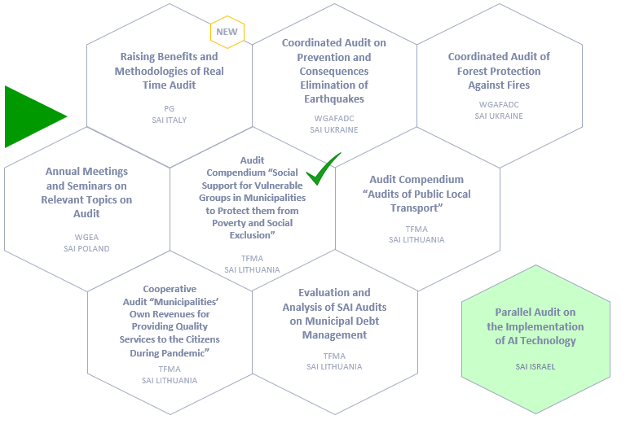
PROJECTS in OBJECTIVE 1
To promote audit-related cooperation by acting as a broker between members
Notes:
I hope everyone is back from the bathroom by now because here comes the very important information:
The annual SG1 meeting will be held on Wednesday 25 January 2023!
Please save the date and let us know if you want to present a new project or require a brainstorming session.

Slide 5
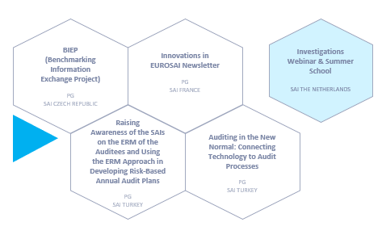
PROJECTS in OBJECTIVE 2
To support the development of innovative audit approaches and methods making use of new technologies
Notes:
I hope everyone is back from the bathroom by now because here comes the very important information:
The annual SG1 meeting will be held on Wednesday 25 January 2023!
Please save the date and let us know if you want to present a new project or require a brainstorming session.

Slide 6
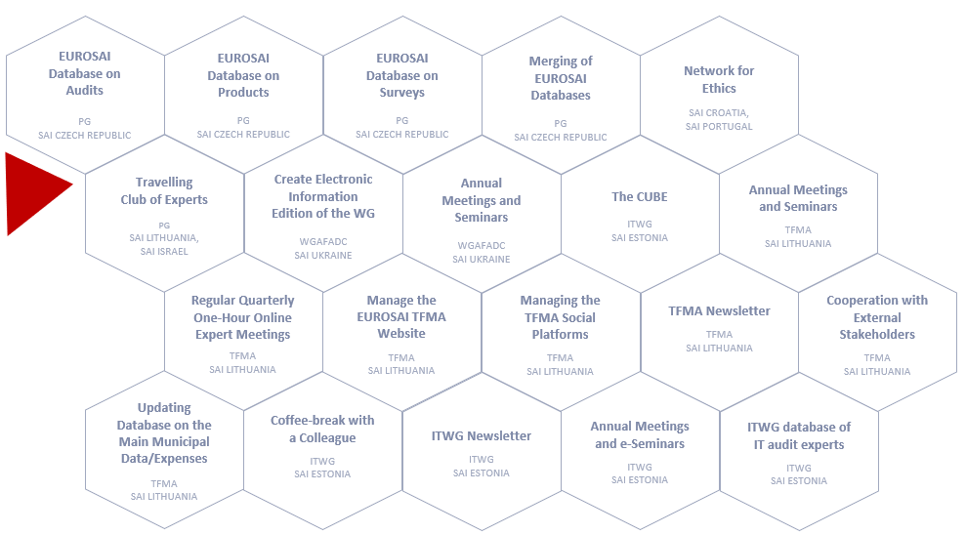
PROJECTS in OBJECTIVE 3
To facilitate the sharing of knowledge and experience within EUROSAI and with external stakeholders and partners
Notes:
I hope everyone is back from the bathroom by now because here comes the very important information:
The annual SG1 meeting will be held on Wednesday 25 January 2023!
Please save the date and let us know if you want to present a new project or require a brainstorming session.

Slide 7
Thank you for your attention!
National Audit Office of Lithuania: international@valstybeskontrole.lt
German Bundesrechnungshof: international@brh.bund.de
Notes:
Thank you very much and I hope to see you all in January!

